Slide 1
Testing the agricultural household model
Econ 591
Rachel Heath

Slide 2
Two quick extensions to AHM
See textbook for more detail
Extension One: Dynamic model
Let c_{st} be a vector of consumption goods in state s of period t
Assuming complete markets in Arrow securities
Recall this allows household to buy contracts that pay off in different states of the world
Allowing for full insurance against risk

Slide 3
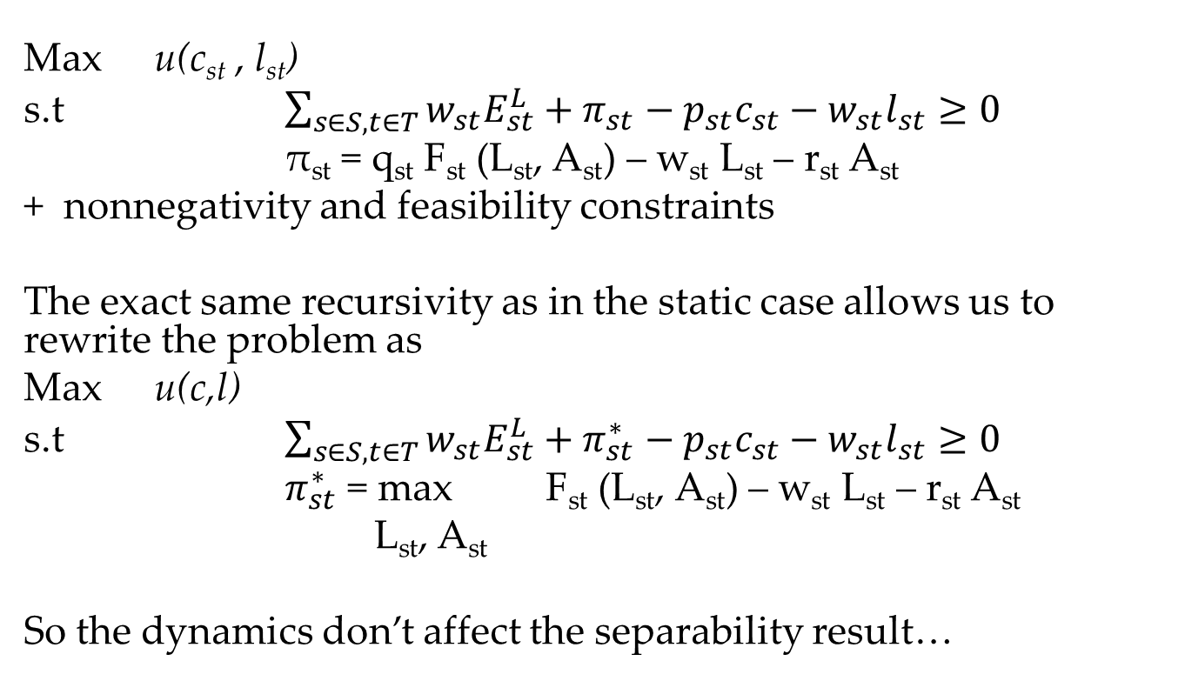
Dynamic AHM
Max u(c_{st} , l_{st})
s.t $\sum_{s∈S, t∈T}{w_{st}E_{st}^{L}+π_{st}−p_{st}c_{st}−w_{st}l_{st}≥0}$
π_{st} = q_{st} F_{st} (L_{st}, A_{st}) – w_{st} L_{st} – r_{st} A_{st}
+ nonnegativity and feasibility constraints
The exact same recursivity as in the static case allows us to rewrite the problem as
Max u(c,l)
s.t $\sum_{s∈S, t∈T}{w_{st}E_{st}^{L}+π_{st}^{∗}−p_{st}c_{st}−w_{st}l_{st}≥0}$
$π_{st}^{∗}$ = max F_{st} (L_{st}, A_{st}) – w_{st} L_{st} – r_{st} A_{st}
L_{st}, A_{st}
So the dynamics don’t affect the separability result…

Slide 4
Add risk
Uncertainty in output (+ risk aversion)
Suppose there’s no land market (so A = E^{A}) and the production has constant returns to scale, so that
θ F(L, E^{A}) = θ E^{A} f(L/E^{A})
where θ is a random variable with mean 1
Suppose households supply labor inelastically
so the only decision is whether to supply labor to market or on own farm
Recall: only the ratio of inputs matters with constant returns to scale

Slide 5
Problem with risk
Max E(u(c))
L≥0
s.t. c = θ E^{A} f(L/E^{A}) + w(E^{A} - L)
FOC: E[u’(c)(θ f’(L/E^{A}) – w)] = 0
Rearrange FOC to get
f’(L/E^{A}) Cov(θ,u’(c)) = E[u’(c)](w - f’(L/E^{A}))
Risk aversion implies that cov(θ, u’(c)) < 0
As θ you get richer and MU consumption falls
So the LHS is negative, and w < f’(L/E^{A})). Household uses inefficiently too little labor on its own land.

Slide 6
Review theoretical predictions of agricultural household model
If markets are complete (or only one market is incomplete/missing)
Production decision is separable from household preferences/endowments
If both land and labor markets are incomplete/missing
Household characteristics do matter for production
Two empirical approaches
test for empirical implications of missing markets, or
test directly whether household characteristics matter for production
Notes:
1 doesn’t necessarily tell us whether agricultural household model is true, but suggests when we may be especially unlikely to see separability between production and consumption

Slide 7
An extreme version of a missing labor market: surplus labor models
Lewis (1954), drawing on even older theories (e.g., Marx), argued that there was "surplus labor" in the countryside.
He argued that "about 25%" of labor had zero marginal value.
Implication: you can move (some) labor from countryside to cities without decreasing agricultural output
Opens up a key question – why doesn’t labor move to cities, then?

Slide 8
Observational evidence of surplus labor
Informally, there seem to be high rates of "unemployment" or "underemployment" in rural areas of developing countries
Classic reference: Walker and Ryan (1990 ICRISAT study) calculated unemployment rates of daily labor
Percentage of workers who tried to get a job on the day labor market but did not succeed
Men 19% (slack season 39%, peak season 12%)
Women 23% (slack season 50%, peak season 11%)
However, not automatic that there is less un/underemployment in urban areas
E.g. Uganda officially reports unemployment rate of 11.7% in urban areas, 1.7% in rural areas
Notes:
So prima facie it seems like we’re in some gray area where markets work but not perfectly. The better markets function, the closer we will get to separability. Note seasonality – we’ll come back to this from time to time throughout the course.

Slide 9
But of course, labor markets don’t seem to fail completely
In Walker and Ryan, there is a daily labor market, and 60-80% of labor use is hired
Although note that existence of a market does not make it “complete”
Although if a market is totally missing (or very thin), that’s often used as prima facie evidence that it’s incomplete.
Frequently the same household buys and sells labor across years, or even within the same year (Fink, Jack, and Masiye 2018 document this in Zambia)

Slide 10
Schultz (1964)
One of the earliest natural experiment studies
Studies the 1917-1918 influenza epidemic in India, which killed 6% of the population and reduced the workforce by about 8%
Idea: if there really was 25% surplus labor, then agricultural output would not fall!
Empirics:
Compares output in 1919-1920 to 1916-1917, which had similar weather
Looks at whether provinces with greater influenza deaths had greater declines in output
Examines acres sown, since does not have direct data on output

Slide 11
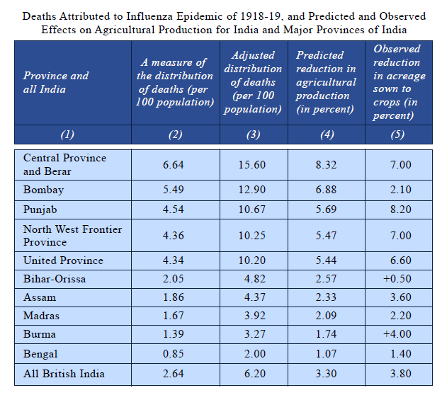
Results

Slide 12
Results
Finds an elasticity of output with respect to population of 0.4
statistically different from zero, with only 10 states!
Amartya Sen’s critique (1967)
Surplus labor of N% understood to mean that there exists a pattern of withdrawal over families and regions such that an N% withdrawal of the labor force from a rural economy will keep output unchanged
How do we know the flu killed the “surplus labor”?
E.g., what if each family has one surplus laborer, but the flu tended to wipe out whole families
Still, a very influential paper – a (very) early example of using an exogenous shock + diff-in-diff strategy to test a commonly-held theory

Slide 13
Benjamin 1992
Test separability: do household characteristics affect labor demand?
Premise: in a world of separability, labor demand on a household’s farm should be unrelated to household characteristics
E.g. Household size, number of children
Instead, they can buy or sell labor at wage w, and only variables in the profit equation should affect labor demand (amount and quality of land, prices of inputs, etc.)
If household characteristics do matter, then presumably there are some transaction costs to hiring in/out labor
And by implication the marginal product of households’ own labor is less than the outside wage (but not necessarily zero)
Use 1980 data on Indonesian rice farmers
Notes:
Remember, profit is a function of exog variables (e.g. w,r)

Slide 14
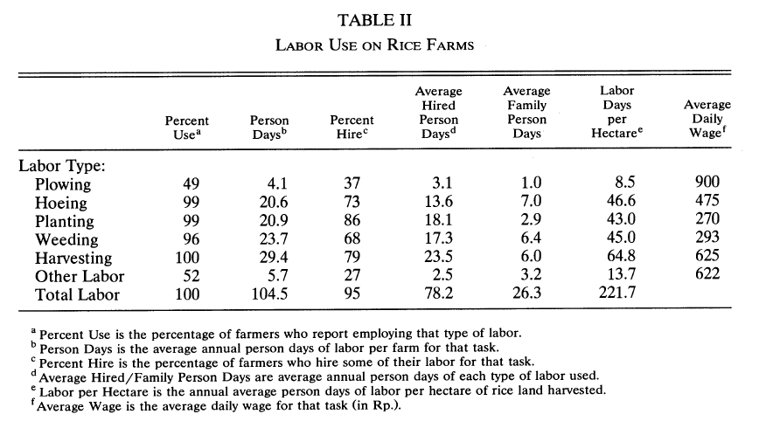
Prima facie evidence that labor markets function well
Notes:
Note that a lower quantity of labor bought/sold doesn’t mean labor market doesn’t work, hh’s could be relatively homogenous – but hard to argue market doesn’t work if there’s this much fluidity

Slide 15
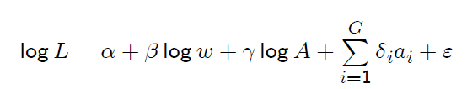
Estimating equation
Labor usage (L) as a function of the market wage (w), amount of land (A) … and household characteristics (a_{i}’s)

Slide 16
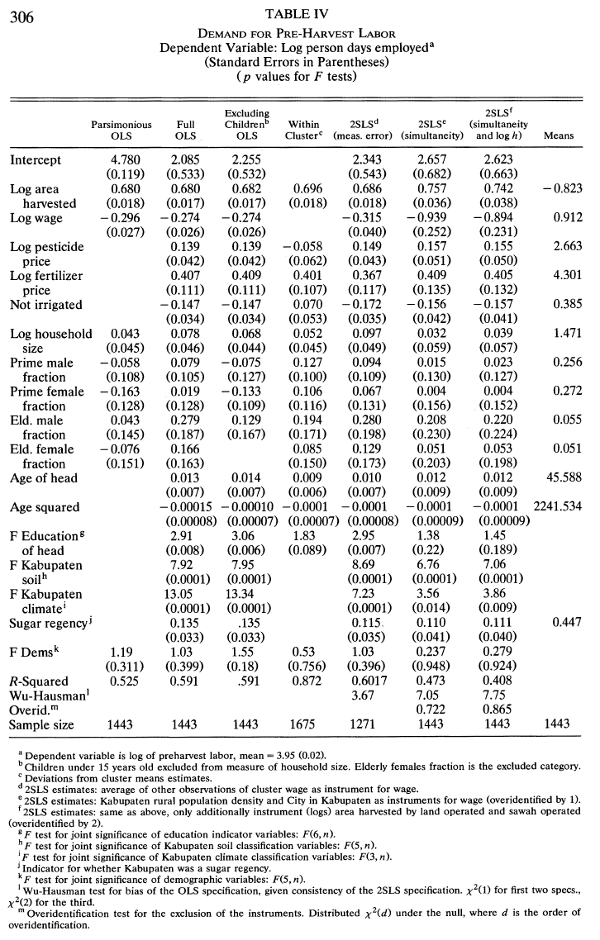
Key result
Cannot reject the null that demographics do not matter: evidence in favor of separability

Slide 17
Do you buy it?

Slide 18
Concerns?
Endogeneity: correlation between ε and a_{i}
Especially because land quality is unobserved
E.g. good land raises income and the family can afford more kids
And also, ceteris paribus, use more labor – if land quality and labor are complementary inputs
Benjamin’s solution: district controls (including soil quality), cluster fixed effects, controls for age, education, and other qualities of hh head
Zero result
Do you have correct functional form? Benjamin’s solution: tries more flexible trans-log
Classical measurement error in demographics?
Family labor reported more accurately than hired labor?
But this may lead to false rejection of separability (would look like demographics predict labor … as you can measure it)
LaFave and Thomas (2016) suggest though that the measurement error is more likely in family labor. (More on them in just a bit. But that does seem plausible.)
Notes:
We are worried about things (like productivity shocks) that would lead hh’s to use more labor – are they correlated with demographics?

Slide 19
LaFave and Thomas (2016)
Simple premise: revisit Benjamin test with panel data
Still Indonesia
But 20 years later (argue if anything, markets have gotten thicker → separability even more likely)
Carefully collected production data
Remind us that Benjamin’s data from a survey intended mainly to measure consumption.
Underestimate household labor? E.g. Benjamin’s data implies that “one household member worked on the farm for one day in each fortnight of the previous year” (p. 1942)
Fortnight = two weeks
Sidenote: this is a really nice example of how to politely explain divergent findings with previous research

Slide 20
When would labor markets fail?
Assume no land market and focus on whether labor market fails. They list some reasons why:
Farm specific experience (Rosenzweig and Wolpin 1993 argues this) or preference for working on your own farm
Asymmetric information
Tendency to shirk + monitoring costs (that are cheaper within family): (Rosenzweig and Wolpin 1993; Bharadwaj 2014)
Unobserved productivity
Transaction costs
E.g. travel time (emphasized in Foster and Rosenzweig 2018)
Any other frictions that would manifest as unemployment in rural labor markets
E.g. we saw an example earlier this class where insurance market failure made you use too little labor in risky venture
They won’t be able to identify which friction matters. This means good news for PhD students looking for research topics: frictions in rural labor markets an open research area. (We’ll come back to this.)
Notes:
Broadly, any reason why hired labor not a perfect substitute for family

Slide 21
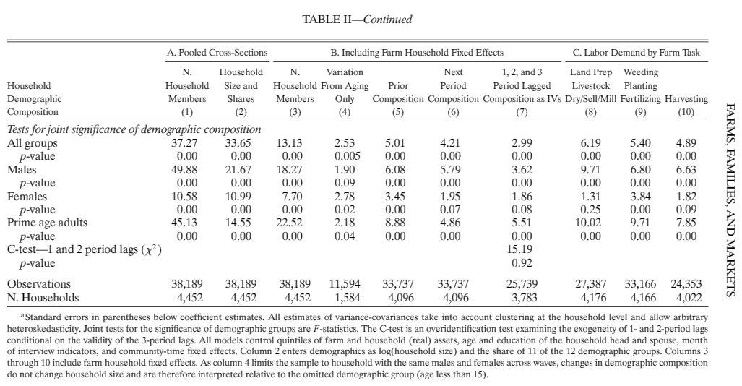
Key finding
As with Benjamin, we’re looking at F-tests of joint significance of demographic variables -- now with household fixed effects
And they now soundly reject them

Slide 22
Should we be concerned household composition still endogenous?
Even with a household fixed effect, are changes in household composition responding to time-varying production shocks?
For household changes due to migration... Maybe
You anticipate a good harvest and your cousin comes to help
But they address this concern by
Considering a specification where they only look at changes in household composition due to ageing
Instrumenting changes in household composition with changes in family composition, unconditional on coresidence
And use lagged composition to instrument for current composition
So we’re no longer worried about contemporaneous shock, although serial correlation could still be a concern
Notes:
Overall, no one test is perfect but together very convincing

Slide 23
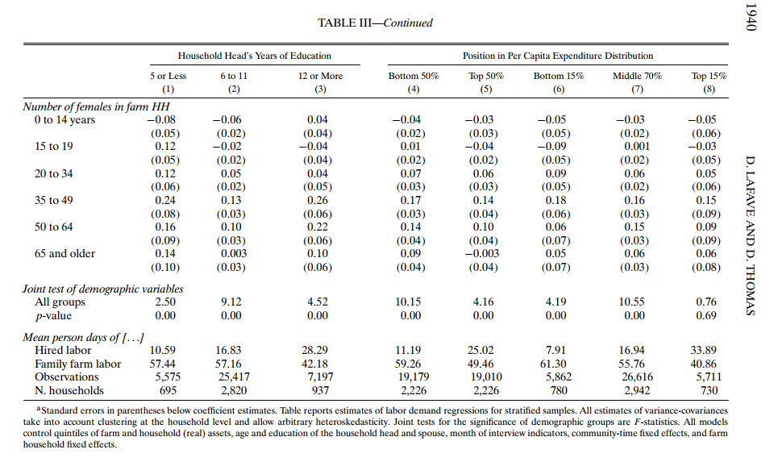
Heterogeneity
Fail to reject for richest households

Slide 24
Implications
Rejecting the null hypothesis of separability doesn’t mean some households’ behavior consistent with complete markets
Rich households better access gains from trade → can create a poverty trap ☹
Consistent with evidence that wealthier households better able to cope with unanticipated shocks (Townsend (1994), Frankenberg, Smith, and Thomas (2003)).
We’ll see a model that can explain this when we study risk

Slide 25
Jacoby (1993)
Estimate the shadow value of a household’s on-farm labor
Important for understanding effects of policies (schooling, migration, fertility)
Also tell us more about rural labor markets
Another test of surplus labor (is it zero?)
Compare the opportunity cost of labor to market wage to test complete markets
Notes:
So we have extremes, going from completely missing labor market (surplus labor) to perfect labor markets (MPL = wage)

Slide 26
Model: main points
As in other papers -- no land markets, but there are labor markets
Separability (or as Jacoby calls it, a recursive model – emphasizes that hh problem is solved in two stages) occurs if family labor is a perfect substitute for hired
Recall that LaFave and Thomas (2016) also discussed the substitutability between family and hired labor
Construct marginal product of labor by estimating the agricultural production function
Y = f(L₁, L₂, X, A, β)
Does the MPL on a household’s own farm equal the wage they get when they sell labor to the market?
Notes:
Shows that shadow value of labor can be estimated even if separability does not hold: Budget may be nonlinear in hours worked, but he linearizes the budget constraint near the optimum

Slide 27
Estimating production functions (1)
When is production shock orthogonal to variable inputs, so that we can get unbiased estimates of the marginal products of those inputs?
If variable inputs must be chosen first (Zellner, Kmenta, and Dreze 1966)
Jacoby doesn’t think that is true, but uses household taste and demographic variables as instruments (note that under separability these wouldn’t have any power)
Imperfect, but argues over-identification tests support his case

Slide 28
Estimating production functions (2)
Ideally, would also use panel data to control for unobserved managerial ability
But in 1993 less data was available…
But with growing availability of panel data, can use IO techniques to estimate production functions
Olley and Pakes (1996) uses investment as a proxy for privately-known productivity shocks
Levinsohn and Petrin (2000) uses intermediate inputs, which they argue are better if there are lots of zeros for investment, like in a developing country context
And probably some even newer techniques (great research opportunities at development-IO intersection)
Again need to be careful of functional form – are you taking derivative of correct function?
Jacoby uses Cobb-Douglass and translog forms

Slide 29
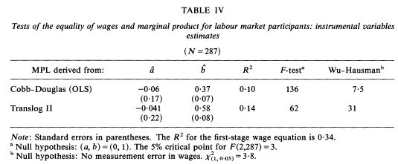
Reject equality of wages and MPL
MPL_{i} = a + b W_{i} + e_{i}
So earn less on own farm than their outside wage. Note this was the opposite prediction of the model with risk (if own farm riskier!)

Slide 30
Why?
Irrationality on the part of farmers
But this shouldn’t be our prior
Biased estimates
Transaction costs
Transportation costs
Disutility of off farm work
Other imperfections in the labor market
Monitoring costs? (Or relatedly, efficiency wages)
Anything else?
Or other missing markets (e.g. insurance). But only if off-farm employment is riskier
Plausible if they have to show up before getting a job?

